Slide 1
Editable Detail Views
30 March 2011
Notes:
Editable Detail Views - <number>
Guidewire training materials contain Guidewire proprietary information that is subject to confidentiality and non-disclosure agreements. You agree to use the information in this manual solely for the purpose of training to implement Guidewire software solutions. You also agree not to disclose the information in this manual to third parties or copy this manual without prior written consent from Guidewire. Guidewire training may be given only by Guidewire employees or certified Guidewire partners under the appropriate agreement with Guidewire.

Slide 2
Lesson objectives
By the end of this lesson, you should be able to:
  Describe the interaction between toolbars and detail views
  Create a toolbar with Edit/Update buttons
  This lesson uses the notes section for additional explanation and information.
  To view the notes in PowerPoint, choose View→Normal or View→Notes Page.
  If you choose to print the notes for the lesson, be sure to select “Print hidden slides.”
Notes:
Editable Detail Views - <number>

Slide 3
Lesson outline
Detail view toolbars
Edit buttons
Notes:
Editable Detail Views - <number>

Slide 4
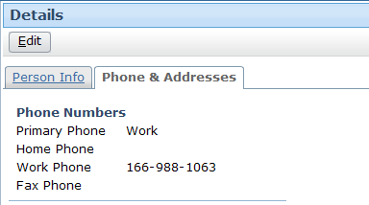
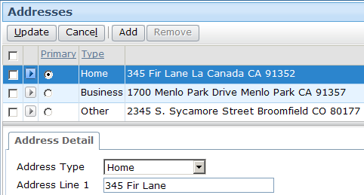
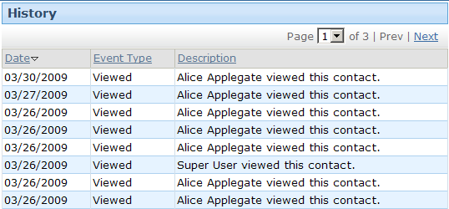
Toolbars
A toolbar is a row of widgets associated with a container widget that lets the user take action on the data in the container widget
  Can be associated with most types of container widgets
Notes:
Editable Detail Views - <number>
Toolbars can be associated with screens, listdetail views, card views, list views, and detail views. They cannot be associated with input sets.
Typically, a toolbar has buttons on it. There are some examples of list views with toolbars that have no buttons, however (as shown in the third example on the slide above). In these situations, the toolbar is needed because the number of items in the list is greater than what can be displayed at one time, and controls are needed to let the user page through the results. The "page through" controls appear on the right of the toolbar.

Slide 5
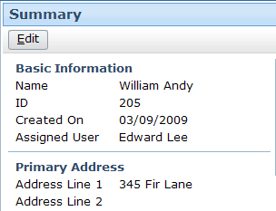
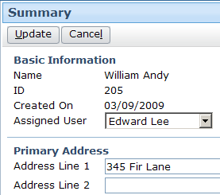
Detail view toolbars
Commonly includes set of three buttons used to edit data in detail view
  Edit
    Enter edit mode
  Update
    Commit changes and return to read-only mode
  Cancel
    Discard changes and return to read-only mode
Notes:
Editable Detail Views - <number>

Slide 6
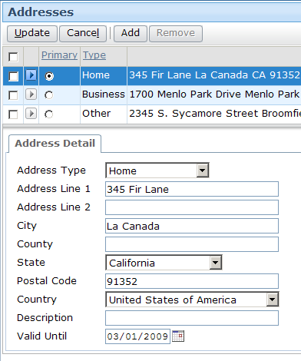
Editable hierarchy
For widget to be editable, every container it resides in must also be editable
screen is editable
listdetail view is
editable
card view is
editable
detail view is
editable
Notes:
Editable Detail Views - <number>
The default value for the editable property of a container widget is true, so container widgets are editable by default.
The default value for the editable property of an atomic widget is false, so atomic widgets such as inputs are read-only by default.

Slide 7
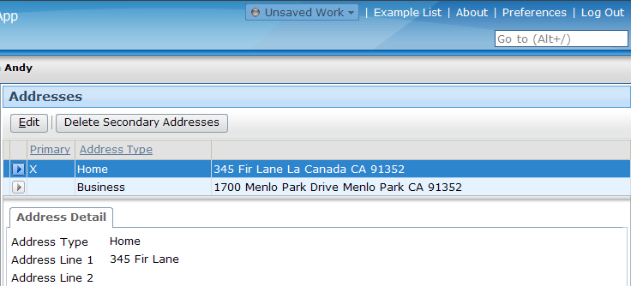
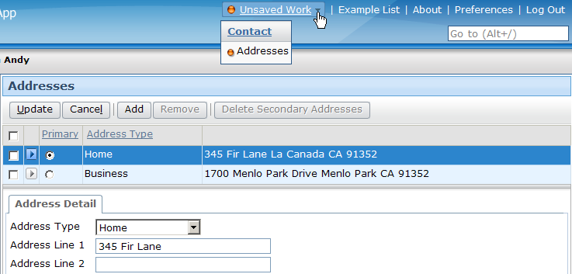
Unsaved Work menu
Whenever you enter edit mode, application automatically adds entry to Unsaved Work menu
  Entry remains until data is committed or you log off
  Users can use Unsaved Work menu to return to unsaved work, even after they navigate away from screen in progress
Notes:
Editable Detail Views - <number>

Slide 8
Lesson outline
Detail view toolbars
Edit buttons
Notes:
Editable Detail Views - <number>

Slide 9
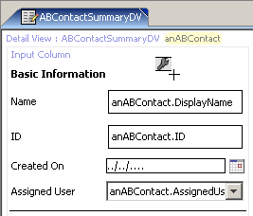
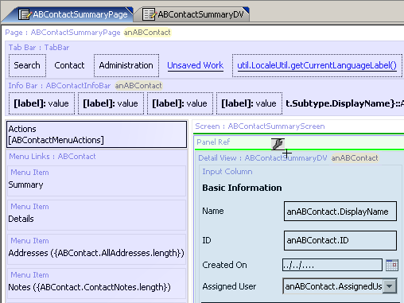
Where can you place a toolbar?
Toolbars cannot be added directly to detail views
  They can be added only to panel refs, secondary views, and screens
no green lines
green lines
Notes:
Editable Detail Views - <number>
Secondary views include card views and listdetail views. (Secondary views are collections of primary views, such as detail views and list views.)

Slide 10
Steps to create edit buttons
Locate panel ref that references detail view
Add toolbar
Add edit buttons
Reload UI metadata
Notes:
Editable Detail Views - <number>

Slide 11
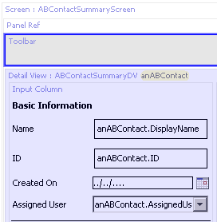
Step 1: Locate panel ref
Step 2: Add toolbar
Notes:
Editable Detail Views - <number>
If you declare the detail view inline and you want to add a toolbar to it, you have to create a panel ref and put the toolbar in the panel ref. The panel ref will not have a specified def property. Its sole purpose is to contain the toolbar.

Slide 12
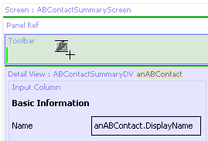
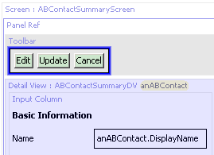
Step 3: Add edit buttons
One tool contains all three buttons
Notes:
Editable Detail Views - <number>
The Edit Buttons tool contains all three buttons needed to make edits: Edit, Update, and Cancel. The buttons also already have the appropriate visibility logic. The Edit button is visible only when the location is in read-only mode. The Update and Cancel buttons are visible only when the location is in edit mode.

Slide 13
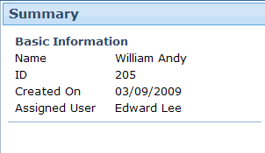
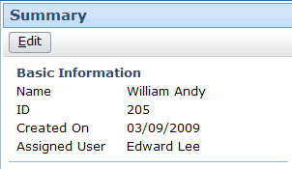
Step 4: Reload UI metadata
Deploy UI changes by entering ALT + SHIFT + L
Notes:
Editable Detail Views - <number>

Slide 14
Lesson objectives review
You should now be able to:
  Describe the interaction between toolbars and detail views
  Create a toolbar with Edit/Update buttons
Notes:
Editable Detail Views - <number>

Slide 15
Review questions
A screen contains a card view that contains a detail view. The detail view contains an input. To allow the end user to change the value of the input, what must be set to editable?
If you want to implement a toolbar for a detail view, what PCF element do you add the toolbar to? (Hint: It is not the detail view itself.)
A given detail view has a blank toolbar. The toolbar requires an Edit button, an Update button, and a Cancel button. In the PCF editor, how many tools must you locate in the toolbox and drag onto the canvas to implement this requirement?
Notes:
Editable Detail Views - <number>
Answers
1. The input widget and all of the containers that directly or indirectly contain it must be editable. The input, the detail view, the card view, and the screen must all be editable.
2. The toolbar is added to the panel ref that references the detail view.
3. You need to drag only one tool, the "Edit Buttons" tool. This tool contains all three buttons.

Slide 16
Notices
Copyright © 2001-2011 Guidewire Software, Inc. All Rights Reserved.
Guidewire, Guidewire Software, Guidewire ClaimCenter, Guidewire PolicyCenter, Guidewire BillingCenter, Guidewire Reinsurance Management, Guidewire ContactManager, Guidewire Vendor Data Management, Guidewire Client Data Management, Guidewire InsuranceSuite, Guidewire ContactCenter, Guidewire Studio, Gosu, Deliver Insurance Your Way, and the Guidewire logo are trademarks or registered trademarks of Guidewire Software, Inc. in the United States and/or other countries.
This material is Guidewire proprietary and confidential. The contents of this material, including product architecture details and APIs, are considered confidential and are fully protected by customer licensing confidentiality agreements and signed Non-Disclosure Agreements (NDAs).
This file and the contents herein are the property of Guidewire Software, Inc. Use of this course material is restricted to students officially registered in this specific Guidewire-instructed course, or for other use expressly authorized by Guidewire. Replication or distribution of this course material in electronic, paper, or other format is prohibited without express permission from Guidewire.
    Guidewire products are protected by one or more of the following patents: U.S. Patent No. 7,885,831; U.S. Patent No. 7,788,296.
Notes:
Editable Detail Views - <number>

